Slide 1
Capstone 1
Ngoc Luu

Slide 2
Importing data and Data Wrangling
Data were downloaded from the World Bank
Each csv file when imported to panda DataFrame will have the columns are the years, rows are countries.
There are 264 rows, more rows than the actual countries because the data also has grouped countries into regions and other categories.
These csv files are named population, gdp, energy as they contain the respective info about the countries. We will call these ‘features’ of the coutries.
Due to data availability, only the years from 1971 - 2014 to be kept for analysis

Slide 3
Importing Data
While import csv files to panda DataFrame:
The first 4 rows will be omitted due to title
Due to data availability, only the years from 1971 - 2014 will be kept
Missing values will be filled with NaN
Other columns: Country Code, Indicator Name, Indicator Code will also be omitted.

Slide 4
Importing Data
After importing and wrangling:
We will have three DataFrames: population, gdp and energy
Each is uniformly shaped: 264 rows by 44 columns
Each row is a country (or region, or a category created by World Bank)
44 columns are years from 1971 - 2014
GDP in US Dollar is the total country as whole; while energy consumption (in kg of oil equivalent) is per person per year, which we will standardize to Total Energy Consumption later on

Slide 5
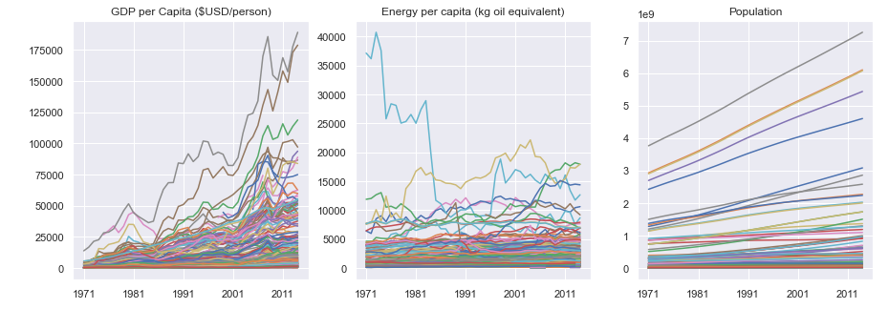
Data Exploratory
By plotting these time series (GDP is converted to per person):

Slide 6
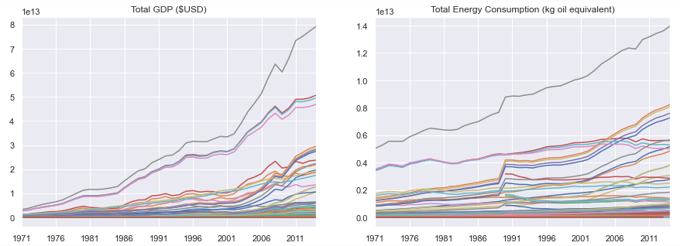
Data Exploratory
Plotting Total Energy Consumption and Total GDP

Slide 7
Data Exploratory
It is a much more complicated relationship when using per person values.
When converting per person value to each country total energy consumption (and GDP) by multiplying the value of that year to its population of the same year, the plot clearly show a better trend.
Perhaps, it is not uncommon to expect the increase in energy consumption over time but it does not always translate to that its citizen is consuming more energy. Perhaps, may be it was due to the development of energy does not keep up with the population increase

Slide 8
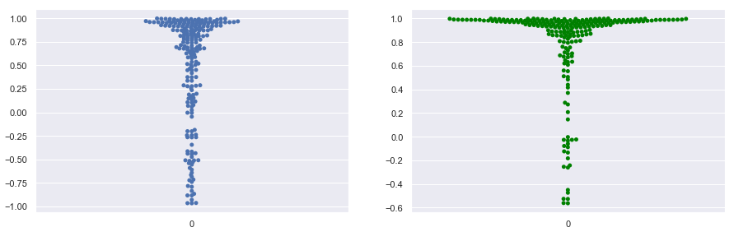
Data Exploratory
Comparing the distribution of the Pearson correlation coefficients between Per Capita and Total values
Using per person value: only 43% (of 264) has a Pearson CCs >= 0.7 against a 66% if Total values were chosen
Energy Consumption; Left: per person; Right: Total values

Slide 9
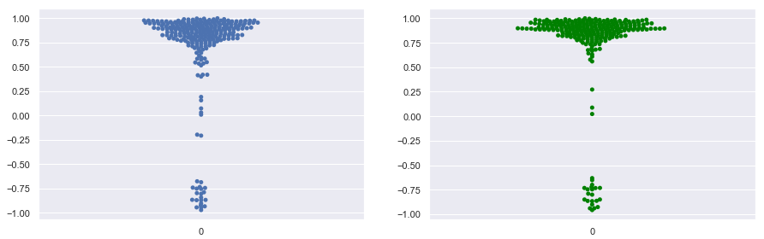
Data Exploratory
https://www.youtube.com/watch?v=ztfkThYIp5c
It is closer for GDP:
79% vs. 85%
GDP; Left: per person; Right: per country

Slide 10
Building population forecasting model for the World
Population was chosen to build the forecasting model because of its almost linear relationship with time.
A linearly observed data would produce the least errors for our model
Although it is not done here but from the predicted (future) values of population we can determine the predicted GDP and Energy Consumption by finding the relationship of Population and these respective feature

Slide 11
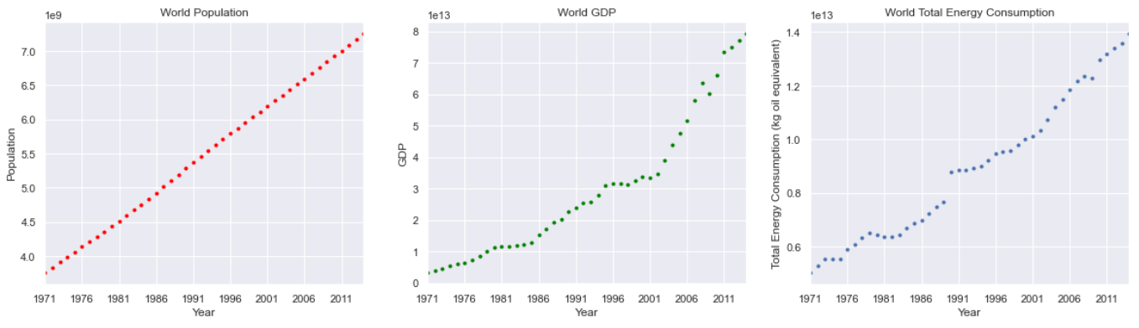
The World: Population, GDP and Total Energy Consumption over the years in graphs

Slide 12
Modeling using scikit and prophet
Scikit:
Here scikit was used to find the best fitted line through the available data.
Predicted future values of population are determined by using the intercept and slope of the best fitted line
Prophet:
New DataFrame to be created to conform with prophet requirements
Future values were handled in the background

Slide 13
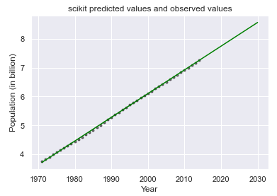
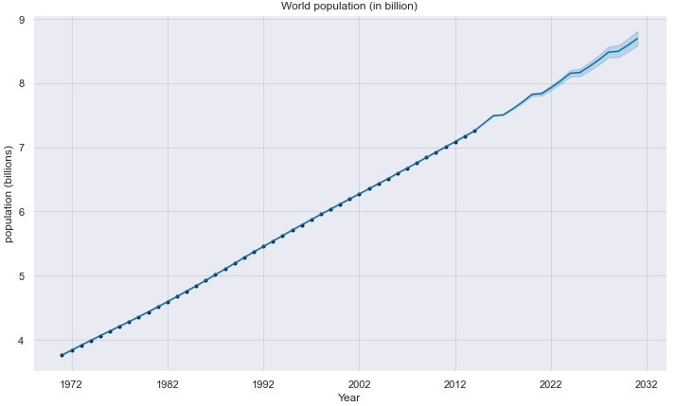
Scikit Prophet

Slide 14
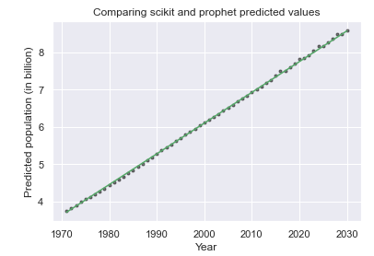

Plotting both scikit and prophet predicted values on the same plot
- Dots are prophet’s values while the green line is scikit’s
- They look very close to each other
- Comparing their performance by determining the RMSE on the observed data (1971 - 2014) shows that prophet’s RMSE is a lot smaller than scikit’s

Slide 15
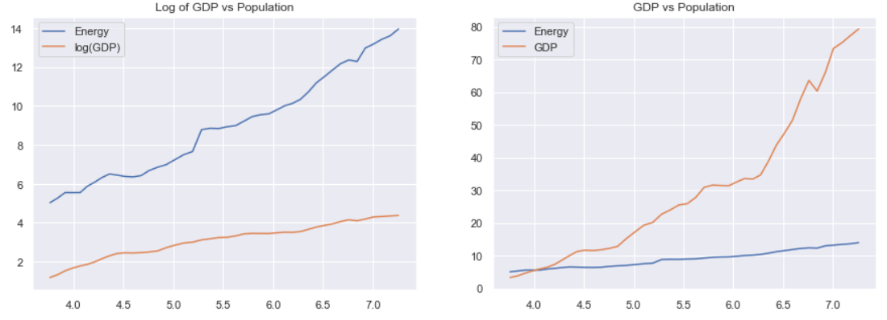
Establishing relationships (GDP vs. Population) and (Total Energy Consumption vs. Population)

Slide 16
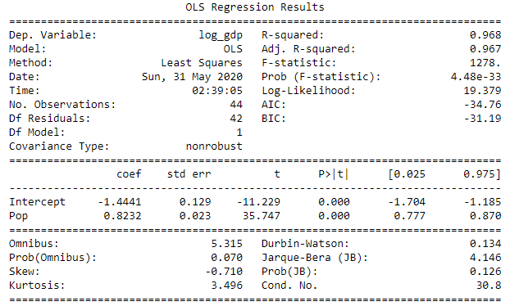
Establishing the relationships using Python statsmodels Ordinary Least Squares (OLS)
Obtaining the slope and y-intercept
log(GDP) vs. Population

Slide 17
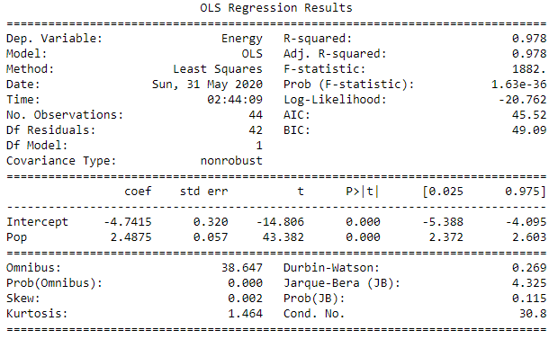
Establishing the relationships using Python statsmodels Ordinary Least Squares (OLS)
Obtaining the slope and y-intercept
Energy vs. Population

